Slide 1
Regulation of Body Temperature

Slide 2
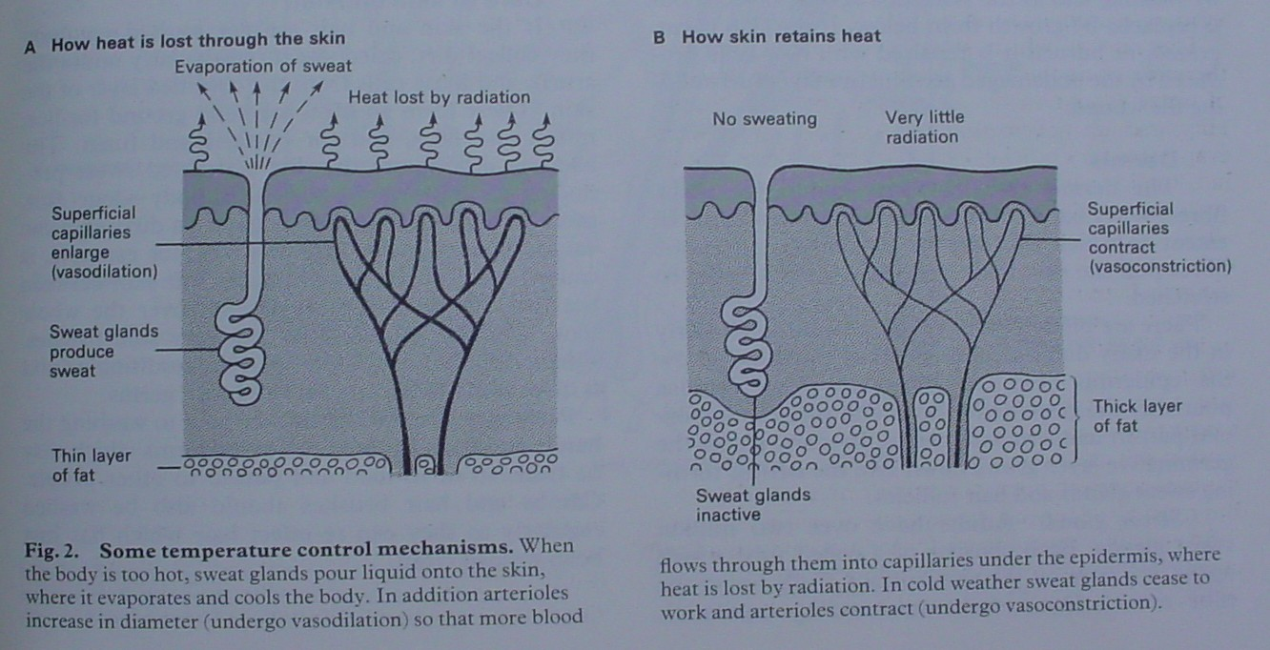
The skin as a regulator
Acknowledgement: Diagram taken from Beckett, Illustrated Human and Social Biology Fig 2 Revised Edition 1984 pg 87

Slide 3
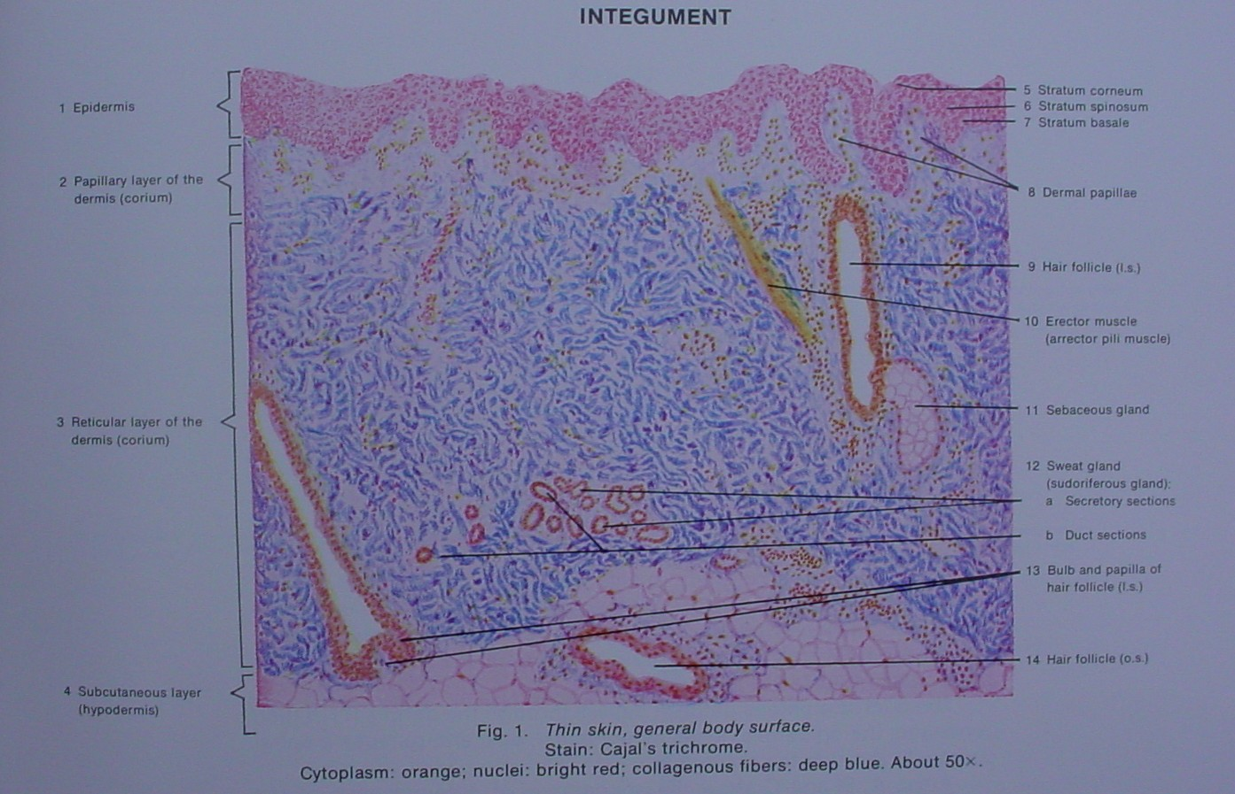
The skin as it appears
Acknowledgement: Picture taken from Mariano S.H. di Fiore Atlas of Human Histology Plate 46 Integument Fifth Edition 1981 pg 105

Slide 4
Changing body temperatures
If the outside temperature is 18ºC then the body needs to gain heat so that our core body temperature is maintained at 37oC.
If the outside temperature is 40ºC then the body needs to lose heat so that our core body temperature is maintained at 37oC.

Slide 5
We can lose heat by: Vasodilation: hypothalamus → nerves → dilation of blood vessels Sweating → hypothalamus → sympathetic nerves → contraction of cells surrounding ducts pump sweat to the skin Inhibiting the sympathetic nervous system and stimulating the parasympathetic nervous system, releasing acetylcholine Decreased production of thyroxine → hypothalamus → anterior lobe of the pituitary gland → thyroid gland →decreased metabolism → decreased heat Behavioural responses: removal of clothing putting on a fan or air conditioner, cold drink or cold bath

Slide 6
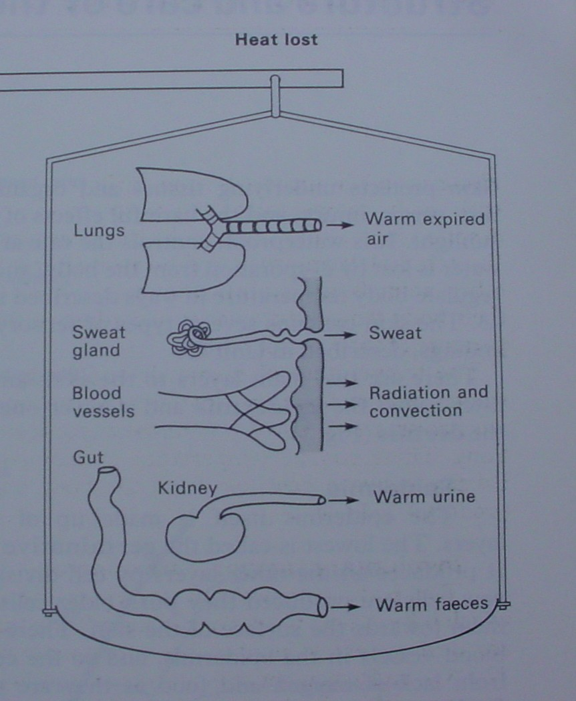
Acknowledgement: Diagram taken from Beckett Illustrated Human and Social Biology Fig 1 Revised Edition 1984 pg 87

Slide 7
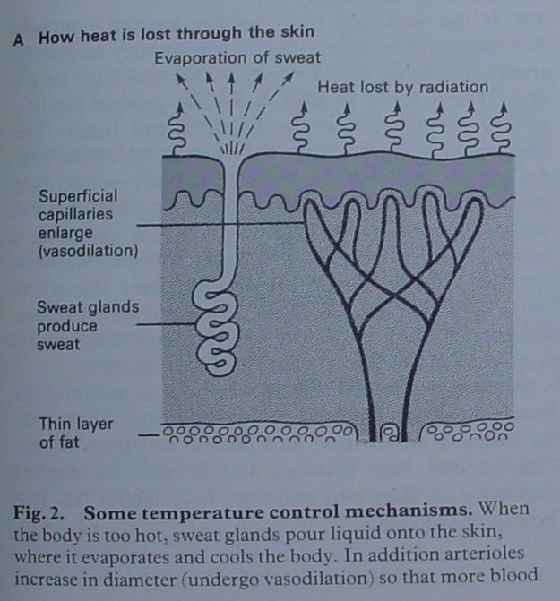
VASODILATION AND SWEATING
Acknowledgement: Diagram taken from Beckett, Illustrated Human and Social Biology Fig 2 Revised Edition 1984 pg 87

Slide 8
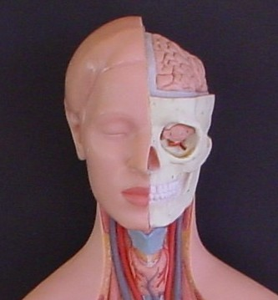
DECREASING THYROXINE
Decrease thyroxine decreases metabolic rate which decreases heat
Acknowledgement: Picture of model from Mentone Educational Centre B13

Slide 9
We can retain heat through: Vasoconstriction: hypothalamus→ sympathetic nerves→ constricting blood vessels to the skin Shivering → hypothalamus → brain → increase muscle tone to increase muscle tremors Stimulating sympathetic nervous system → sympathetic nerves → the adrenal medulla → adrenaline and noradrenaline Increased production of thyroxine → hypothalamus → anterior lobe of the pituitary gland → thyroid gland → increased metabolism → increased heat Behavioural responses: putting on an extra jumper, seeking shelter from the cold, running around, putting on a heater

Slide 10
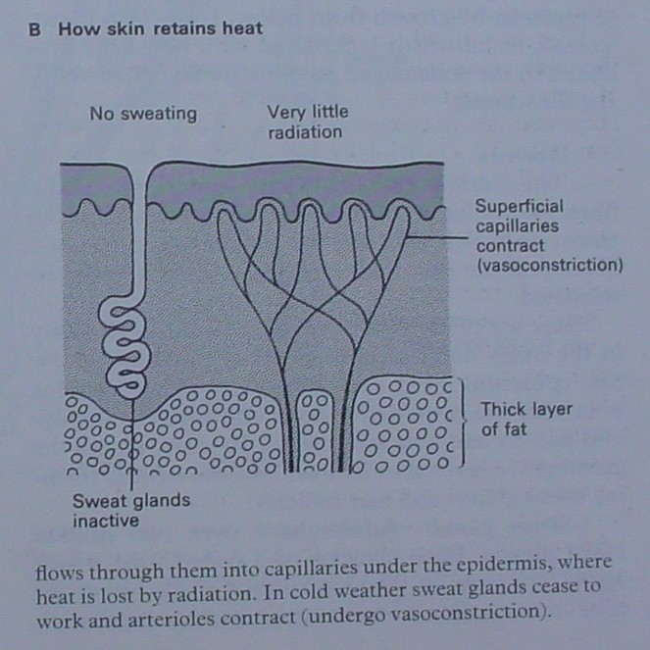
VASOCONSTRICTION
Acknowledgement: Diagram taken from Beckett Illustrated Human and Social Biology Fig 2 Revised Edition 1984 pg 87

Slide 11
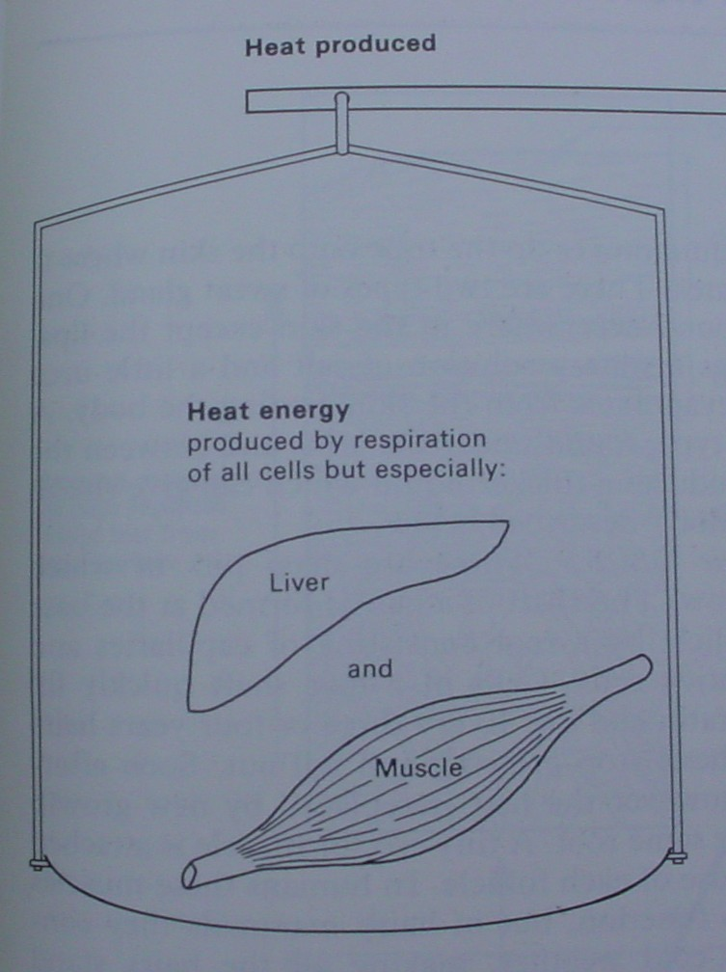
SHIVERING
Acknowledgement: Diagram taken from Beckett Illustrated Human and Social Biology Fig 1 Revised Edition 1984 pg 87

Slide 12
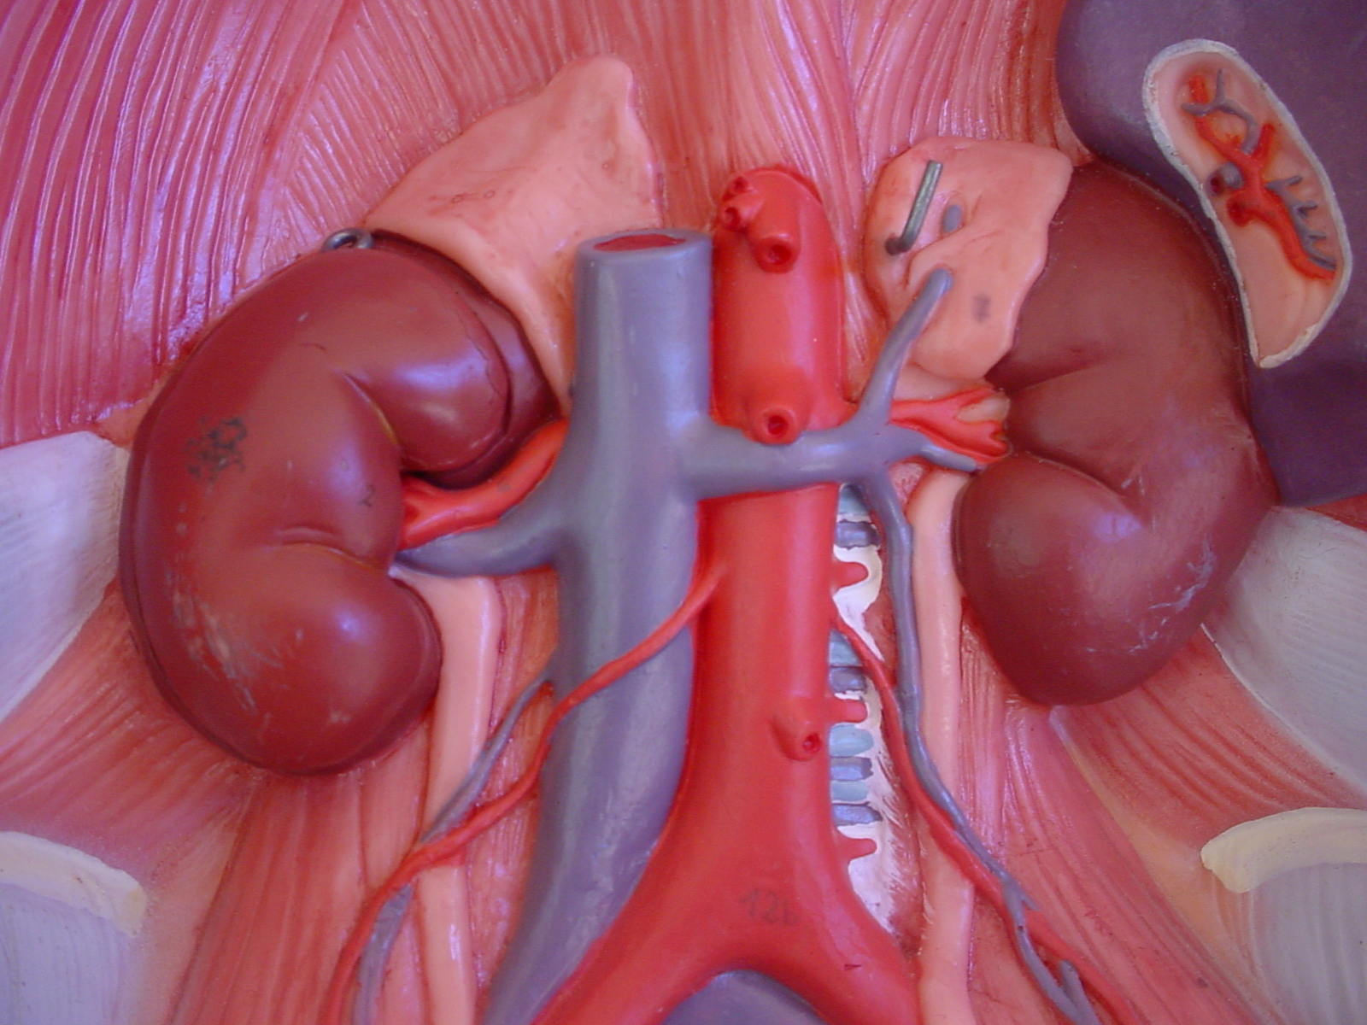
SYMPATHETIC NERVOUS SYSTEM
Adrenal glands are stimulated to produce adrenaline and noradrenaline which in turn increases the action of the body (flight or fight) which in turn increases the production of heat within the body.
Acknowledgement: Picture of model from Mentone Educational Centre B13

Slide 13
INCREASING THYROXINE
Increase thyroxine increases metabolic rate which increases heat.
Acknowledgement: Picture taken from Mentone Educational Centre B13

